Slide 1

SafeLAN: Adaptive Secure File System for LAN environment
RP-25-26J-067

Slide 2
Introduction
SafeLAN is a LAN-based secure file system that utilizes advanced mechanisms such as keystroke dynamics, mouse movements, hand gestures, blockchain technology to improve the current security state of file systems.

Slide 3
Research Objectives
Research problem
Many advanced security features today are internet or cloud-dependent. As a result, LAN only environments are left with much weaker protections.
To build a secure desktop-based file management system for Local Area Network environments.

Slide 4

IT22328298 | Waidyarathne u h a p g
Behavioural Biometrics-Based Adaptive Authentication Module for SafeLAN
Specialization: Cyber Security
IT22328298| Waidyarathne U H A P G | 25-26J-067

Slide 5
Behavioural Biometrics-Based Adaptive Authentication Module for SafeLAN
Problem: Current LAN-based file systems authenticate users by validating only the correctness of credentials, without verifying who is typing them. Once logged in, these systems cannot detect insider threats or credential misuse, making them vulnerable when valid credentials are used by unauthorized individuals. This issue is critical in offline LAN environments, where centralized identity services like user-specific keystroke data and trust-score based authentication are unavailable.
User Requirements Addressed:
Identity Validation: Confirms that the person typing is the legitimate user.
Low Intrusion: Uses existing keyboard input without extra hardware.
Compatibility: Designed to integrate into a LAN-based desktop file system and works without internet.
IT22328298 | Waidyarathne U H A P G | 25-26J-067

Slide 6
Behavioural Biometrics-Based Adaptive Authentication Module for SafeLAN
Design Excellence/ Contribution
Centralized server–client architecture for secure storage and management of user-specific authentication models.
Uses One-Class SVM, which is suitable for authentication scenarios where only legitimate user data is available and attacker data is unknown.
Effective for small, user-specific datasets, making it practical for per-user enrollment.
Detects anomalies at login time using 14 keystroke dynamics (hold time, flight time, key latencies, etc.), even when correct credentials are entered.
Implements a threshold-based trust score, enabling controlled tuning of false positives and false negatives.
Uses integration of contextual factors like device UUID, MAC address and host name match while learning user's successful typing attempts to keep authentication accurate.
IT22328298 | Waidyarathne U H A P G | 25-26J-067

Slide 7
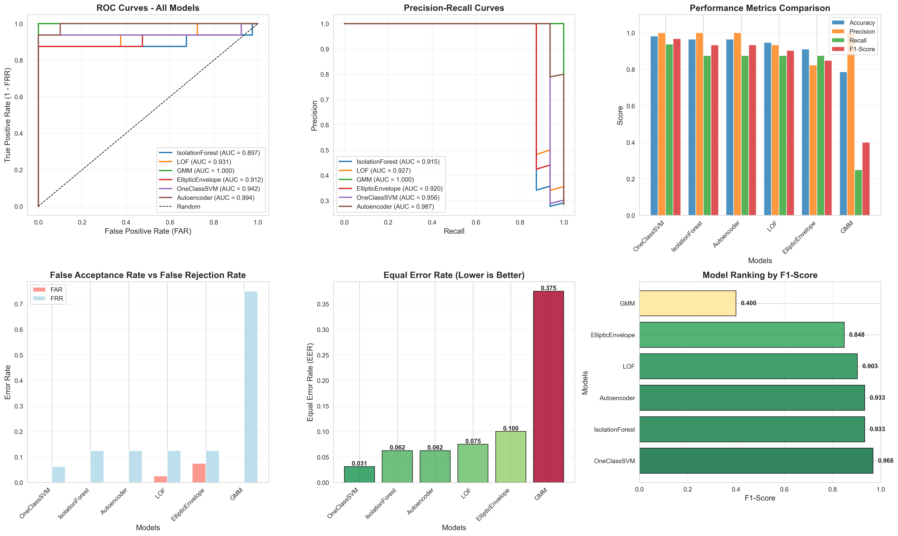
Behavioural Biometrics-Based Adaptive Authentication Module for SafeLAN
Among the evaluated models, One-Class SVM performed best with low FAR/FRR and the highest overall classification metrics, making it ideal for our authentication module.
IT22328298 | Waidyarathne U H A P G | 25-26J-067

Slide 8
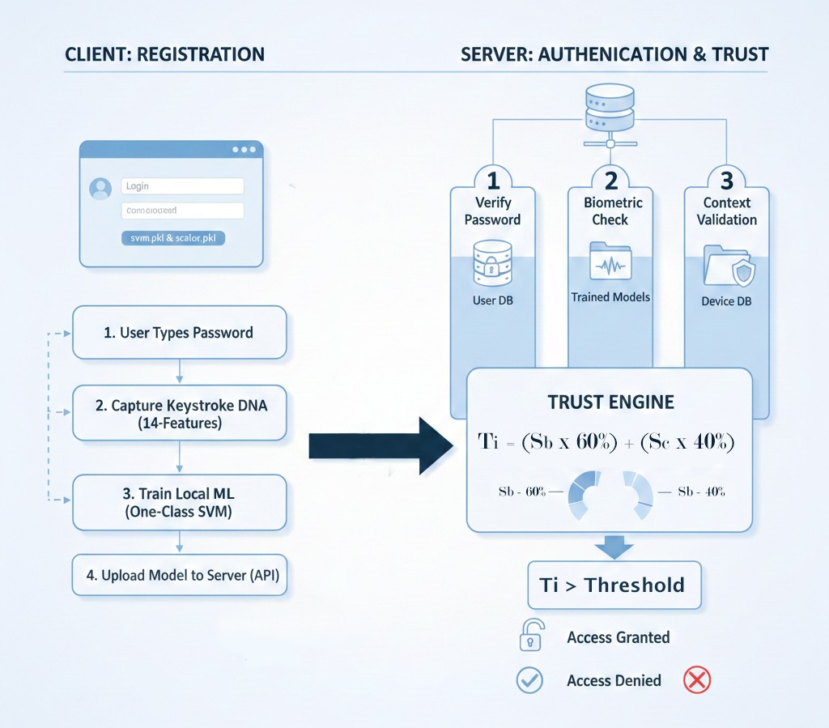
Behavioural Biometrics-Based Adaptive Authentication Module for SafeLAN
Authentication Module Process
User types the password, keystroke features are captured to create the user’s typing DNA and model is trained and uploaded to the server via API.
The server verifies the password, evaluates keystroke behaviour using the stored SVM model and generates a trust score by combining biometric (60%) and contextual (40%) scores.
The final trust score is compared with a threshold to grant, challenge or deny access.
IT22328298 | Waidyarathne U H A P G | 25-26J-067

Slide 9

Behavior Anomaly Detection using Machine Learning to Ensure Continuous Authentication
BSC (HONS) DEGREE IN INFORMATION TECHNOLOGY (SPECIALIZATION IN
CYBER SECURITY)
IT22029386 | Wahalathanthri C D | 25-26J-067

Slide 10
Behavior Anomaly Detection using Machine Learning to Ensure Continuous Authentication
How the solution addresses the sub-problem / prototype Continuous authentication detects abnormal behavior and stops session hijacking during active LAN sessions.
User requirements addressed by the solution Secure file access, real-time monitoring, low user disruption, and fast detection/response to suspicious activity.
Design excellence / contribution Uses ML-based behavioral analysis (multi-context) to provide adaptive, continuous security beyond traditional login methods.
User feedback on prototype Easy to use, minimal interruptions, improved confidence in session security — highlighted need to add face recognition and remove keystroke focus.
IT22029386 | Wahalathanthri C D | 25-26J-067

Slide 11
Behavior Anomaly Detection using Machine Learning to Ensure Continuous Authentication
Commercialization/Sustainability Scalable security platform for organizations; licensing + subscription model ensures long-term updates and support.
Customer Persona IT admins, cybersecurity teams, SMEs, enterprises, government, healthcare, and finance organizations handling sensitive data.
Market Size Rapidly growing global cybersecurity market (billions USD), driven by insider threats and secure LAN requirements.
What is Unique in Your Solution Session-level continuous authentication using ML + behavior analytics (and face recognition) specifically designed for LAN environments.
How Will the Cost Be Recovered? Software licensing, SaaS subscriptions, customization services, training, and maintenance contracts.

Slide 12

IT22323002 | HIRIMUTHUGDODA N A
Secure file viewing with a new biometric to lockdown browser
Specialization: Cyber Security
IT2323002 | HIRIMUTHUGODA N A | 25-26J-967

Slide 13
Secure file viewing with a new biometric to lockdown browser
Problems addressed:
Privacy issues when storing biometric data.
Deepfakes.
Users fall victim to phishing links
Brute-Forcing 2FA codes sent.
IT22323002 | Hirimuthugoda N A| 25-26J-067

Slide 14
Secure file viewing with a new biometric to lockdown browser
Design Excellence:
Incorporates stability filtering (multiple consecutive frames) to reduce false detections.
Fully offline operation, reducing dependency on external services and networks.
No Data Storage required, less costly.
IT22323002 | Hirimuthugoda N A| 25-26J-067

Slide 15

IT22892744 | Dias w p s
Dual-Visibility PoA Blockchain for SafeLAN
Specialization: Cyber Security
IT22892744 | DIAS W P S | 25 – 26J - 067

Slide 16
Dual-Visibility PoA Blockchain for SafeLAN
Traditional audit logs in LAN-based file systems are stored centrally and can be easily tampered with, deleted, or fabricated by administrators or attackers. This lack of immutability and transparency undermines accountability, making forensic investigations unreliable. Current logging systems cannot prevent insider threats from manipulating access records, leading to security vulnerabilities in organizations that operate without internet connectivity, where centralized identity services and real-time external verification are unavailable.
User Requirements Addressed:
• Immutability: Ensures audit logs cannot be altered or deleted, even by administrators.
• Transparency: Both file owners and receivers can independently verify file access events.
• Offline Operation: Works entirely within the LAN without internet dependency.
• Dual Visibility: Standard users see only their own logs; administrators see all logs for audit purposes.
IT22892744 | Dias W P S | 25 – 26J - 067
Notes:
This solution addresses the identified sub-problem by introducing a dual-visibility blockchain explorer for the SafeLAN system. The main objective is to provide tamper-proof audit logging for file access activities while avoiding unnecessary exposure of sensitive blockchain data. By using a Proof-of-Authority consensus mechanism, only trusted system authorities are allowed to validate and add blocks, which ensures both data integrity and controlled access within the LAN environment.
From a user requirements perspective, the solution allows regular users to view only their own transaction and file access logs, while administrators are able to audit the full blockchain for monitoring and compliance purposes. The system is designed to operate entirely within an offline local area network, without relying on public blockchains or internet connectivity, while still ensuring immutability, traceability, and accountability of file access events.
In terms of design excellence, the solution implements dual visibility to balance transparency and privacy, and uses a Proof-of-Authority blockchain that is efficient and suitable for permissioned environments. The architecture clearly separates the GUI, API, and blockchain layers, improving maintainability and security. Additionally, a user-friendly desktop blockchain explorer was developed, supporting search, refresh, and real-time log viewing, making it easy for both users and administrators to interact with the system.

Slide 17
Dual-Visibility PoA Blockchain for SafeLAN
Design Excellence / Contribution
• Uses Proof of Authority (PoA) consensus, which is efficient for private LAN networks where validators are pre-approved trusted nodes, eliminating energy-intensive mining.
• Implements transaction batching, collecting up to 50 transactions before creating a block, reducing blockchain bloat by 50-100x and improving query performance by 100x.
• Integrates Merkle trees for efficient O(log n) transaction verification instead of O(n), enabling cryptographic proof without checking all transactions.
• Employs a permissioned blockchain architecture with dual-visibility access control, where administrators audit all events while users view only their own transaction history.
• The design enables smart contract validation to enforce role-based permissions, ownership rules, and security policies(time restrictions, rate limiting) before blockchain entry.
IT22892744 | Dias W P S | 25 – 26J - 067
Notes:
Based on initial prototype feedback, users found the blockchain explorer intuitive and easy to use, and it increased their confidence in the system’s transparency. Administrators particularly appreciated the clarity and reliability of the immutable audit logs, which support effective monitoring and investigation.

Slide 18
SafeLAN: Adaptive Secure File System for LAN environment
Target Marketplace : Small to Medium scaled organizations.
Uniqueness: Various security implementations in LAN environment.
Notes:
The overall idea of this solution is to improve security and accountability within Local Area Network environments by integrating multiple security mechanisms into a single system. The solution is primarily targeted at small to medium scale organizations, such as educational institutions, offices, and government departments, where internal file sharing is common and security resources are often limited.

Slide 19


